Slide 1



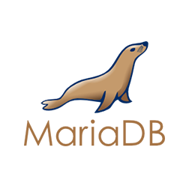
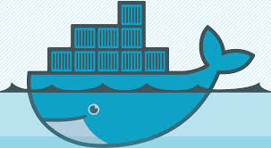






CI/CD education project
Developed by: Teliatnikov M.G
1

Slide 2

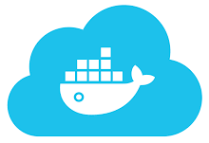

AWS Server
Webhook
Build image
Push docker image
Pull image
Push code
Docker Hub
Dockerfile
Ansible Playbook
Install docker and pull docker images from Docker hub
AWS Host
2

Slide 3
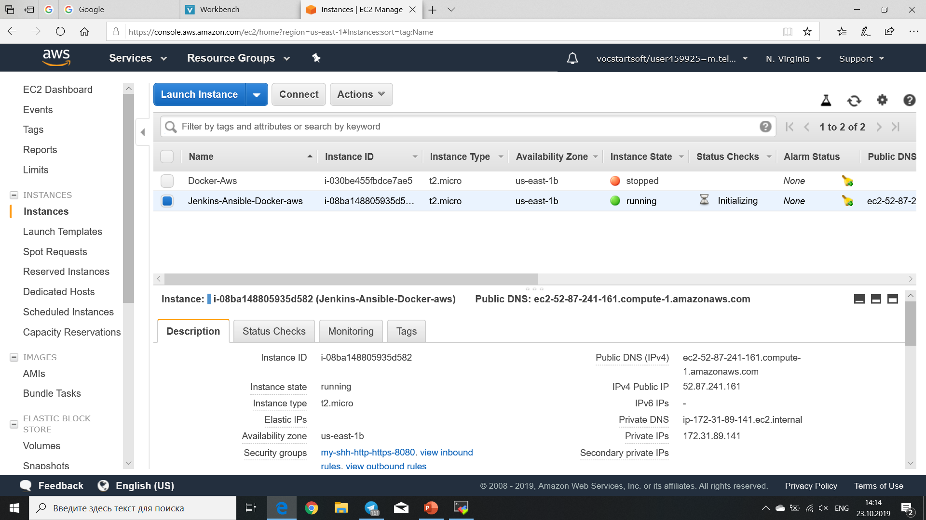
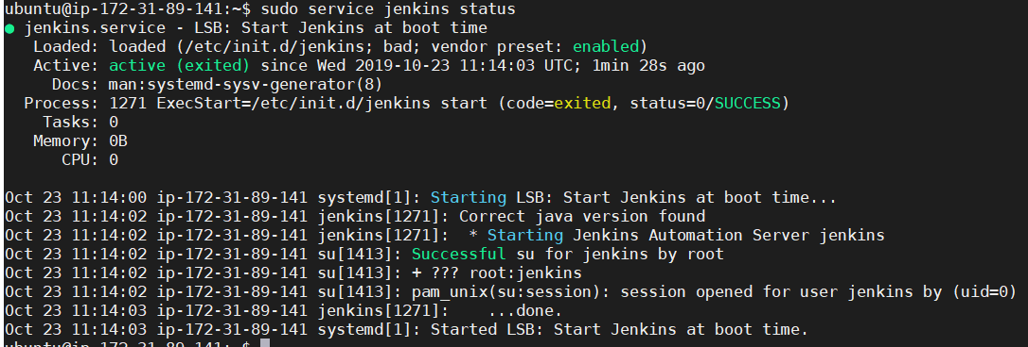
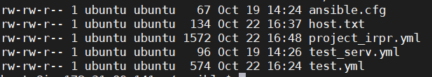
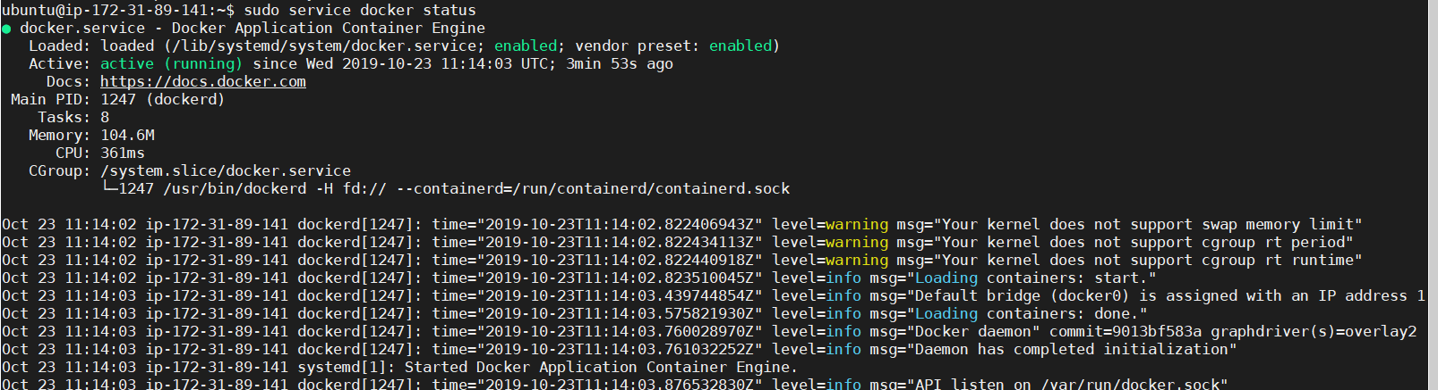
AWS Server Status
Jenkins
Ansible files
Docker
3

Slide 4
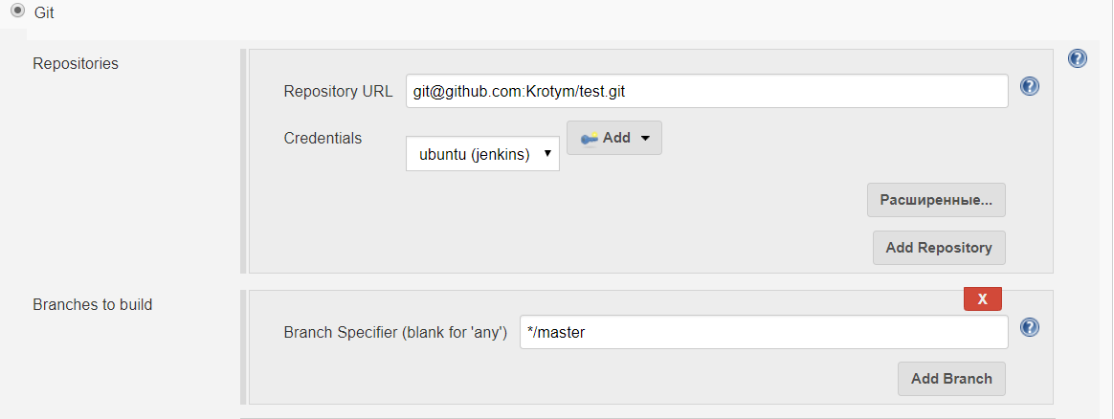
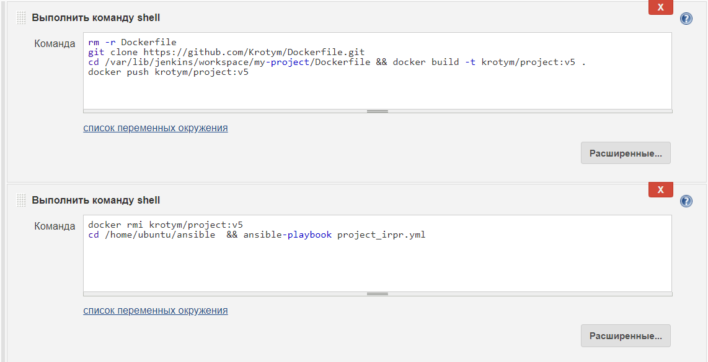
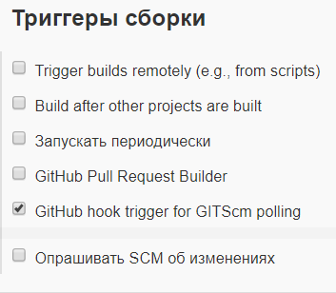
Jenkins
Github repository with my code web-site. I start Jenkins command before webhook from github. In command I delete dockerfile and clone new dockerfile form github next step I create new image and push on Docker hub repository. Finish step I delete docker image and start Ansible playbook
Jenkins Shell Command
Github Repository
Jenkins Trigger
4

Slide 5
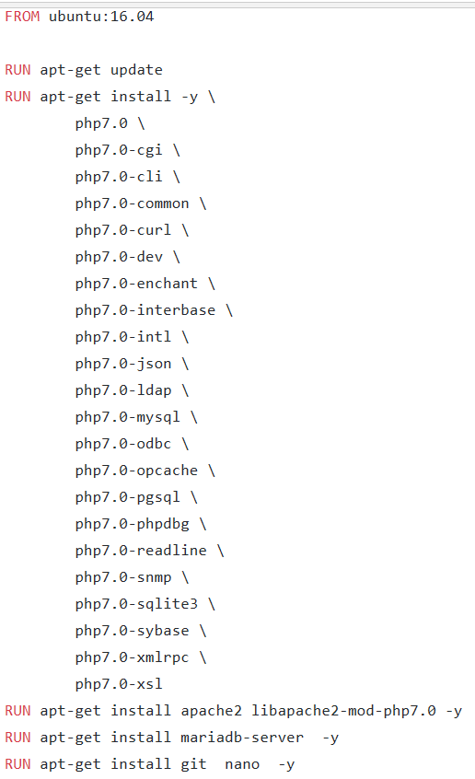
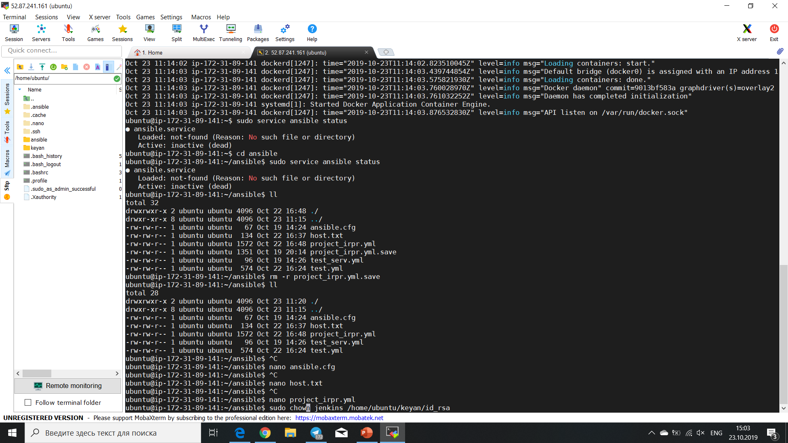
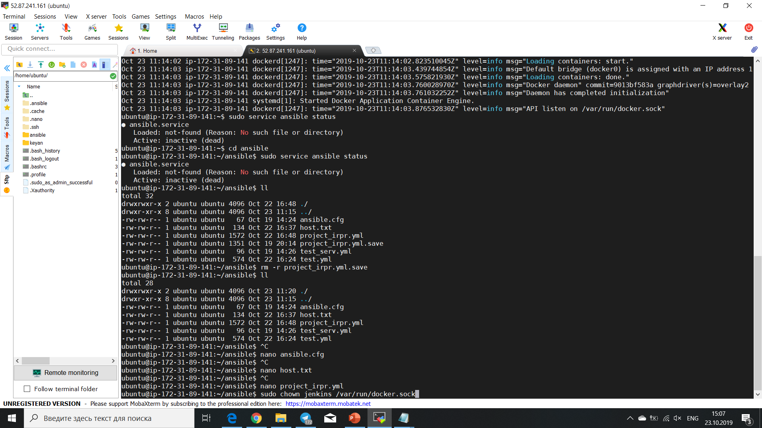
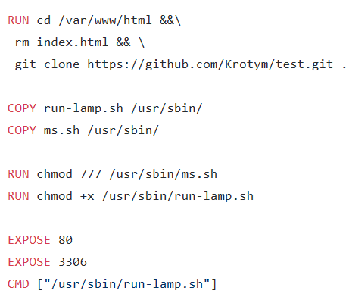
Dockerfile and acсеss to file
Dockerfile
Access to ssh private key
Access to docker for build image
This is text my dockerfile and command for access Jenkins at files with private key and docker.sock.
If not running this command, Jenkins be give a error access.
Dockerfile
5

Slide 6
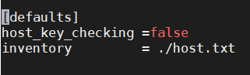
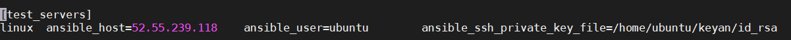
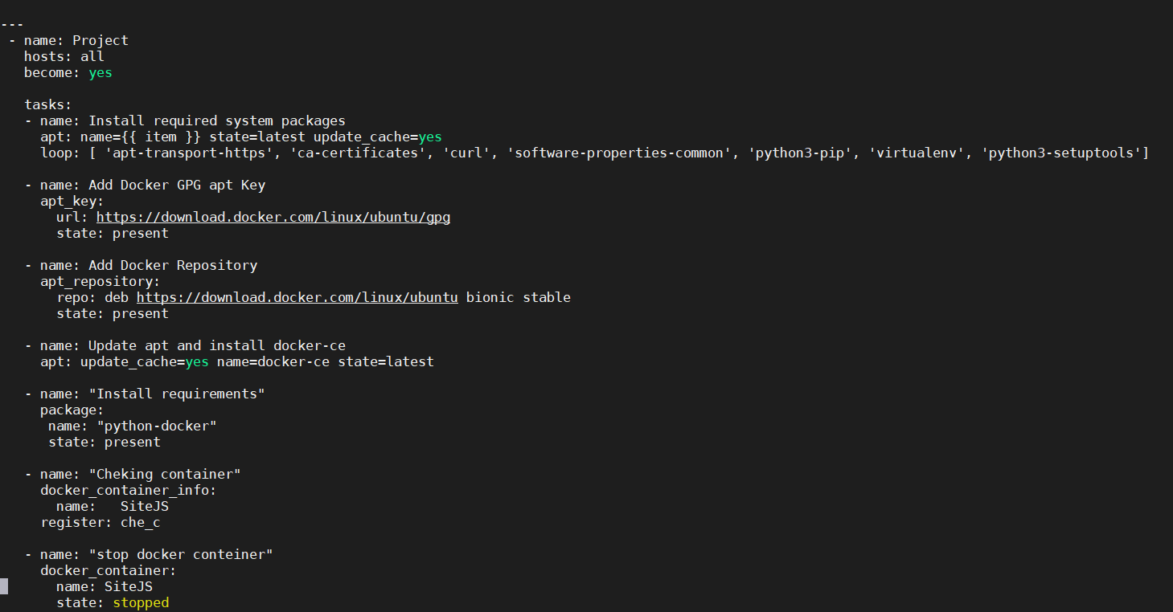
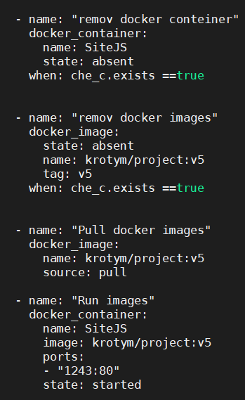
Ansible files
host.txt
ansible.cfg
project_irpr.yml
project_irpr.yml
Task this playbook: Install docker on host machine and if was image remove he, next step pull new image and run he
6

Slide 7
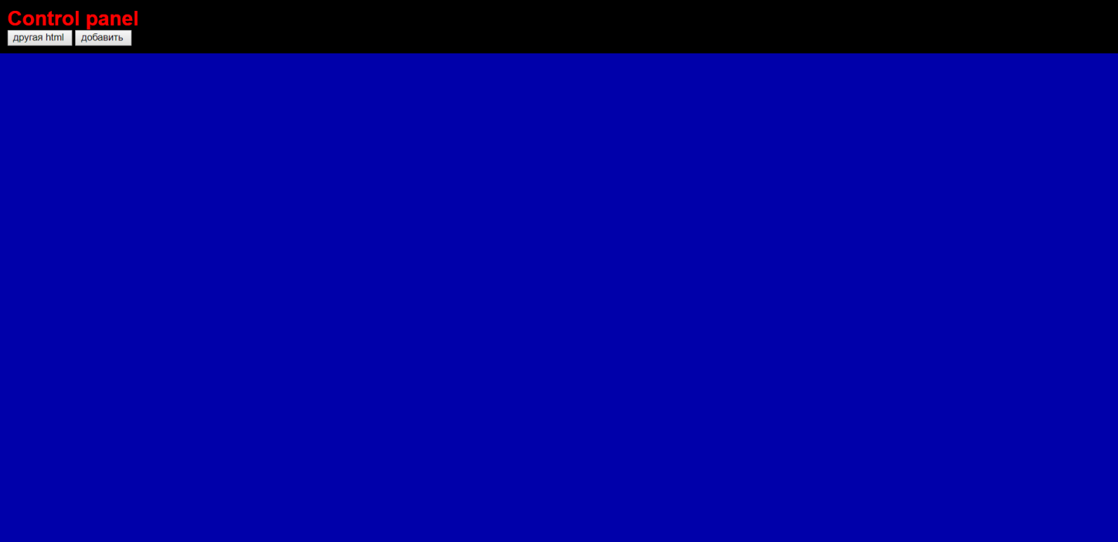
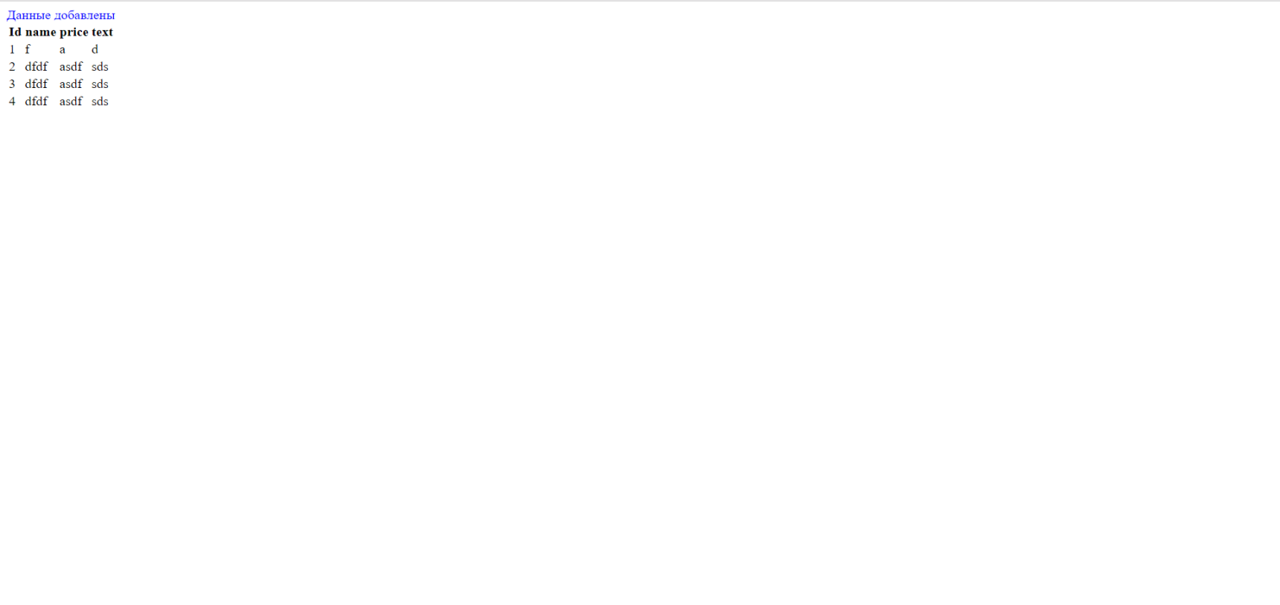
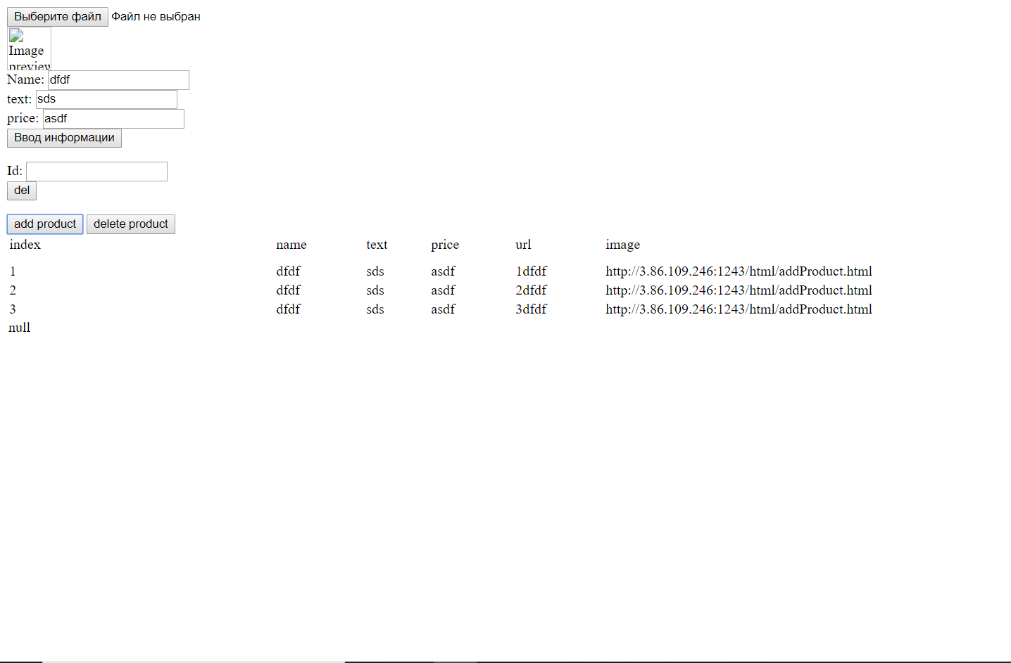
On screenshots show my site. By key “добавить” we going on form input: key “Ввод информации” add date in database, key “add product” add date in local memory.
7

Slide 8
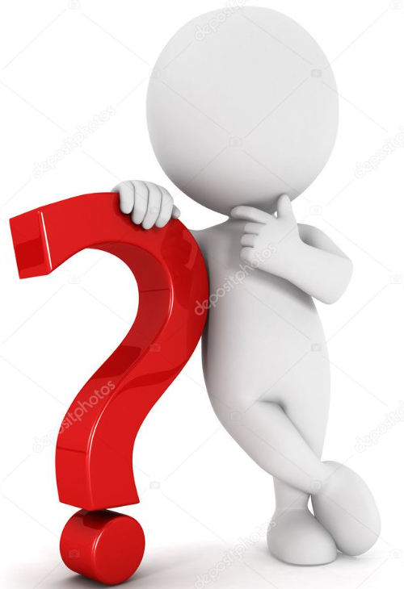
Questions?
35.174.5.191:1243
8

